Slide 1

VLC Android Medialibrary
Presentation by Group 3

Slide 2
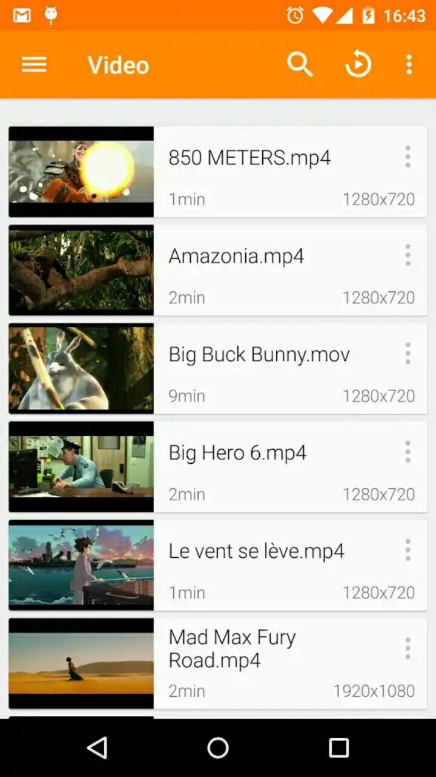
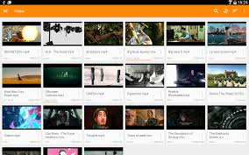
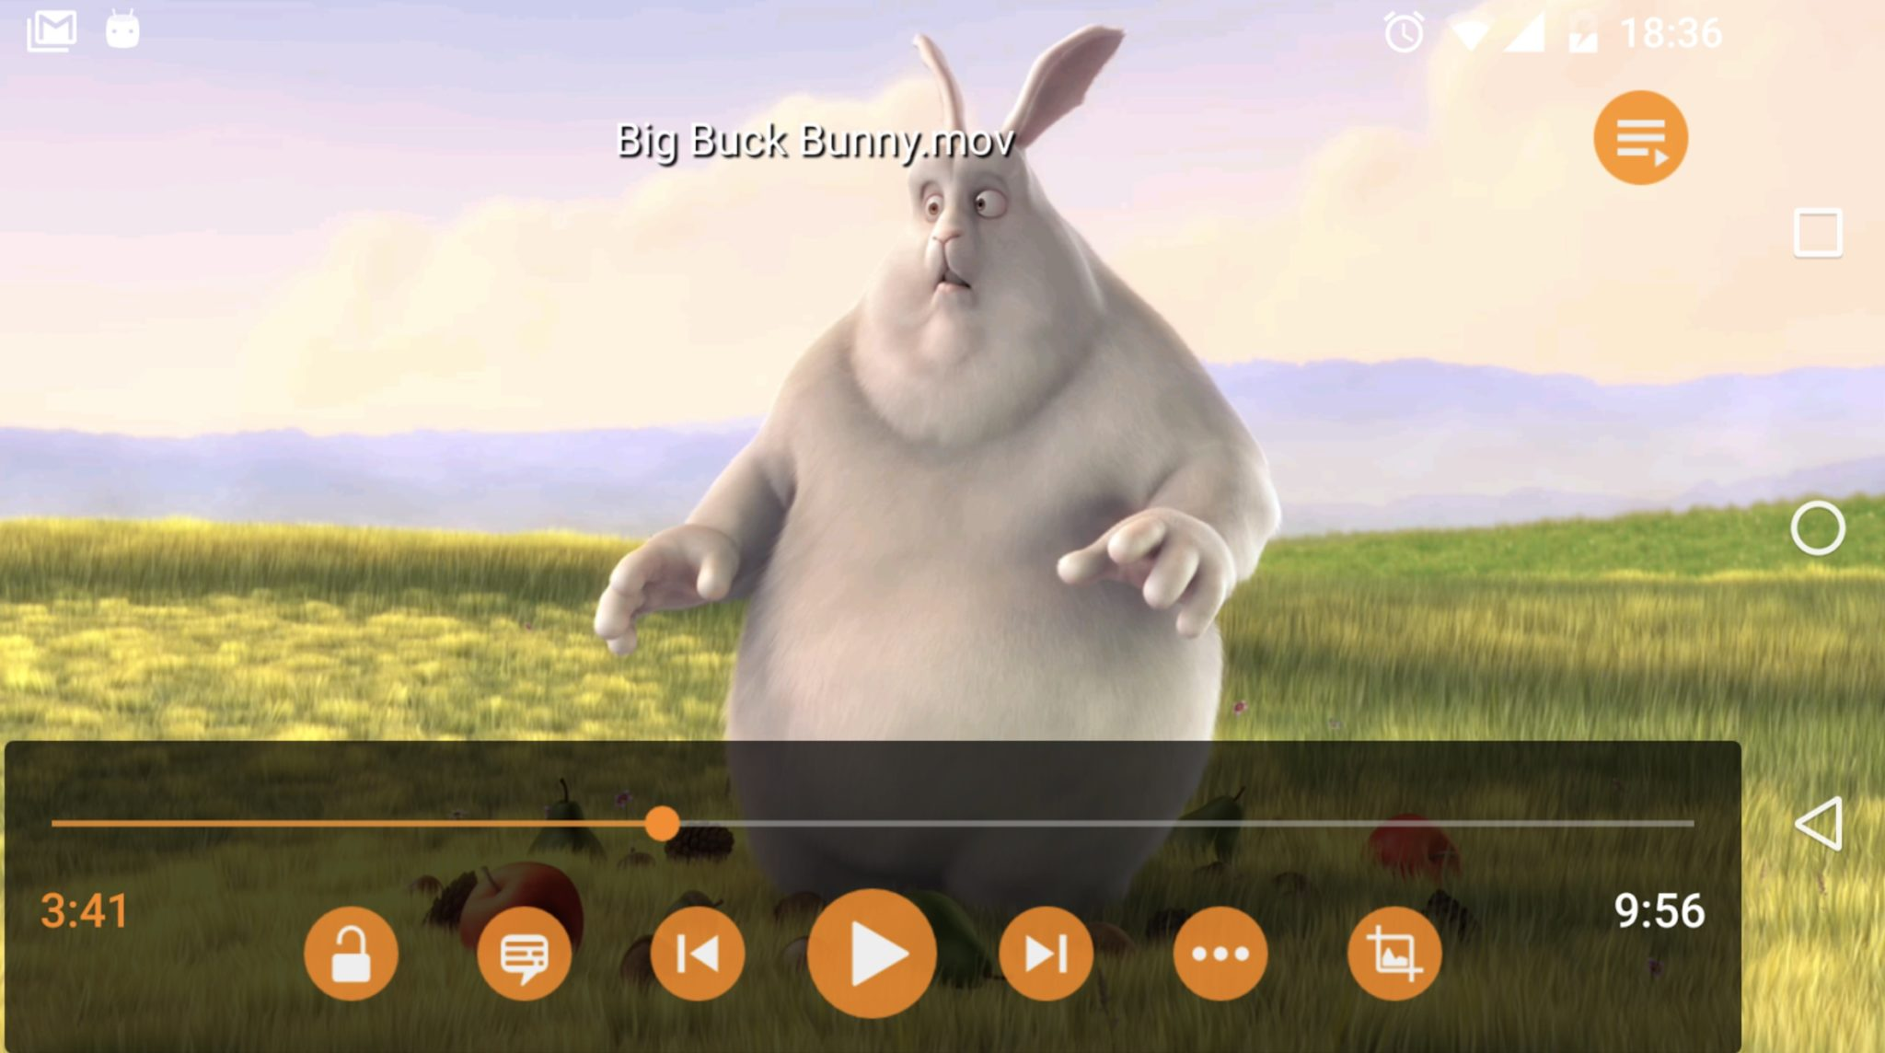
What is VLC?

Slide 3
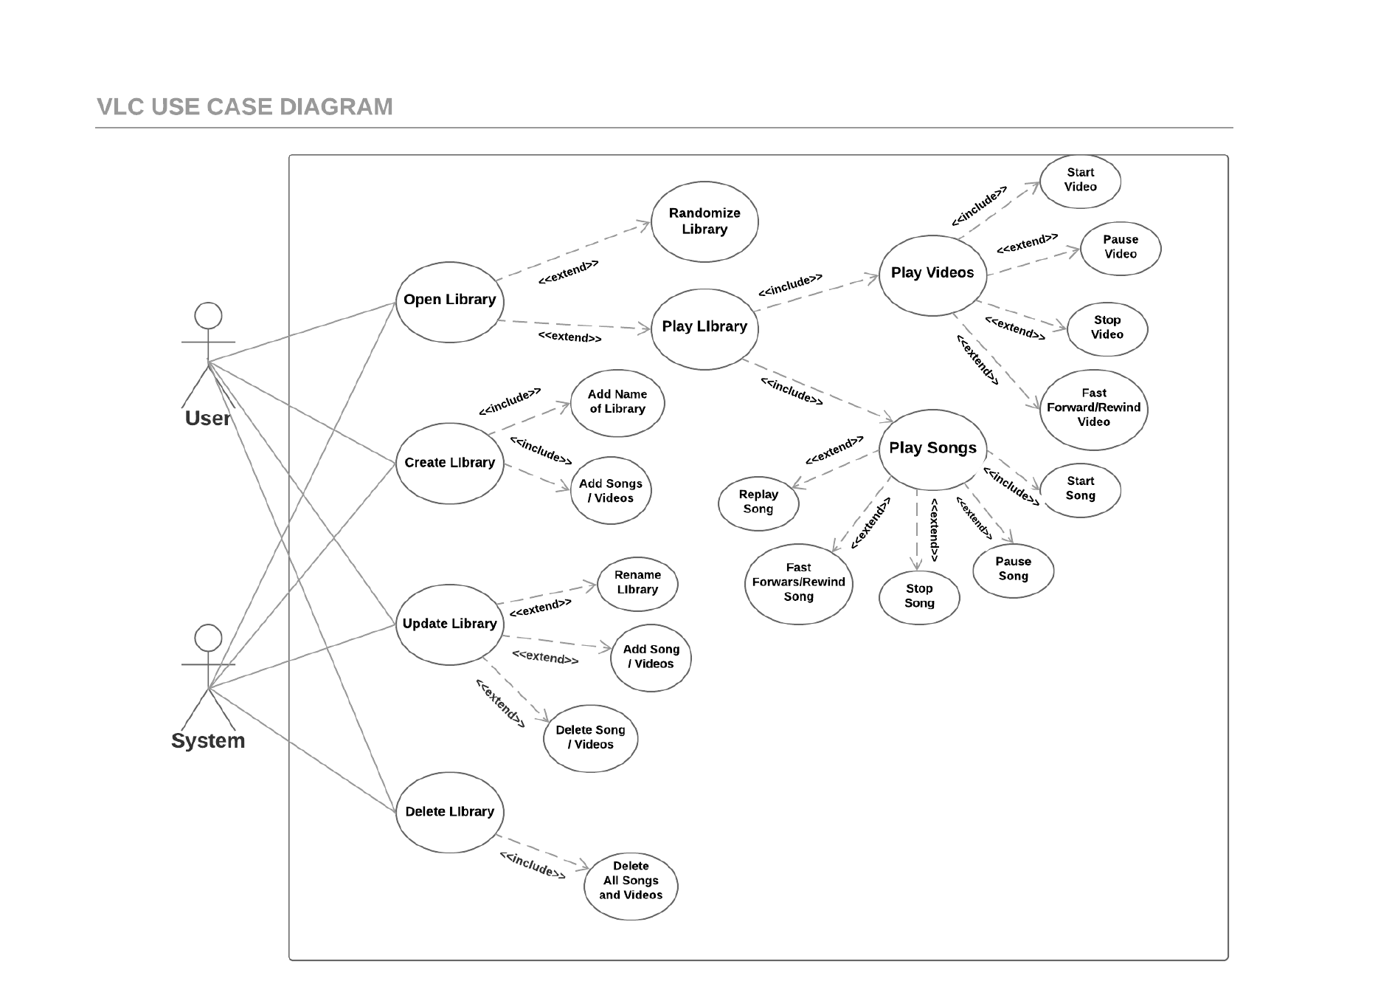
Use Case Diagram

Slide 4
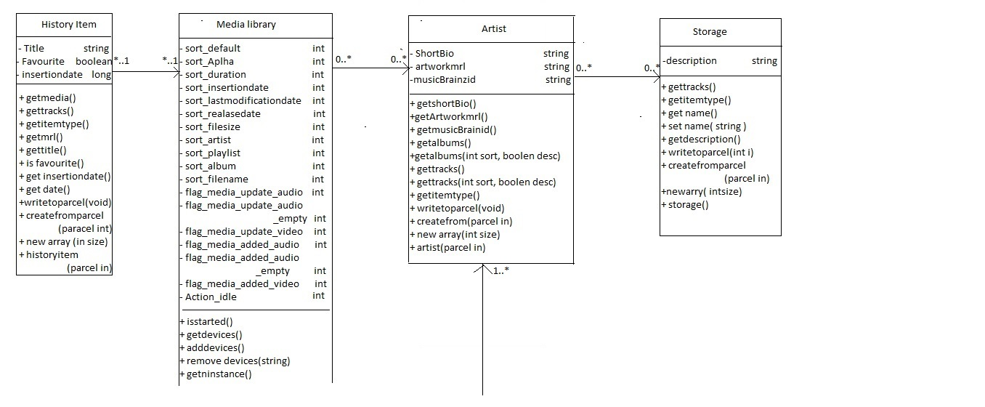
Class diagram

Slide 5
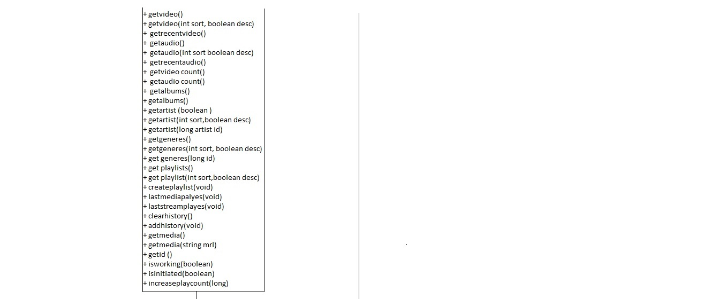

Slide 6
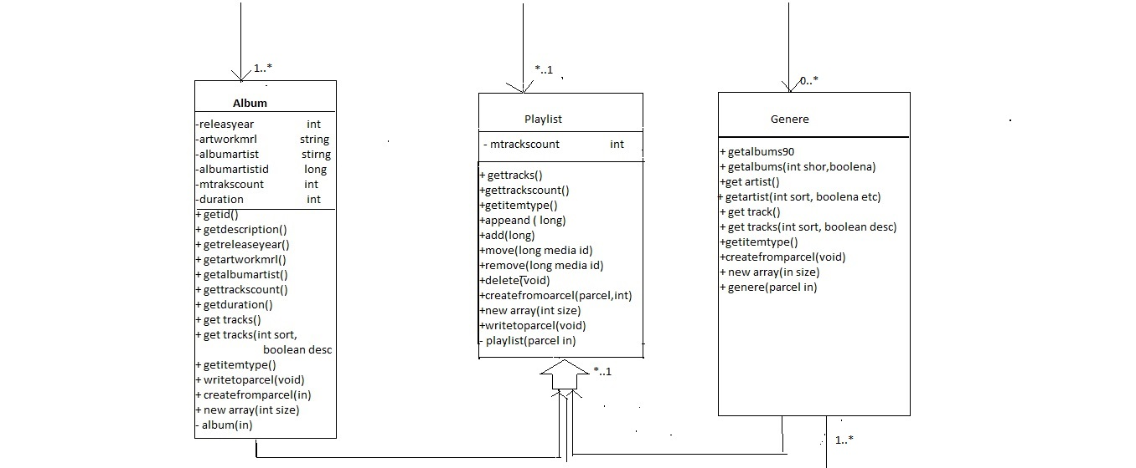

Slide 7
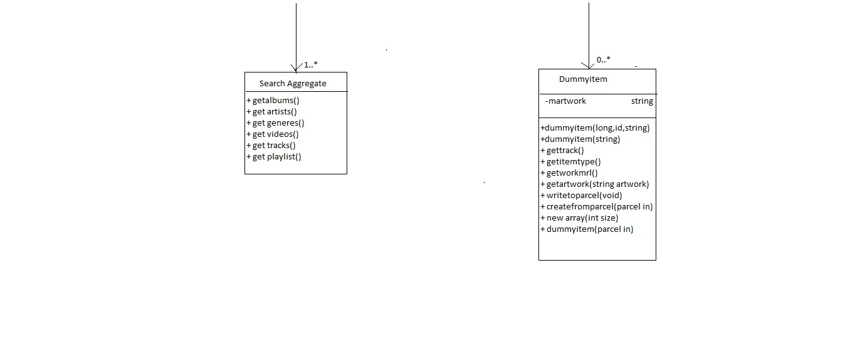

Slide 8
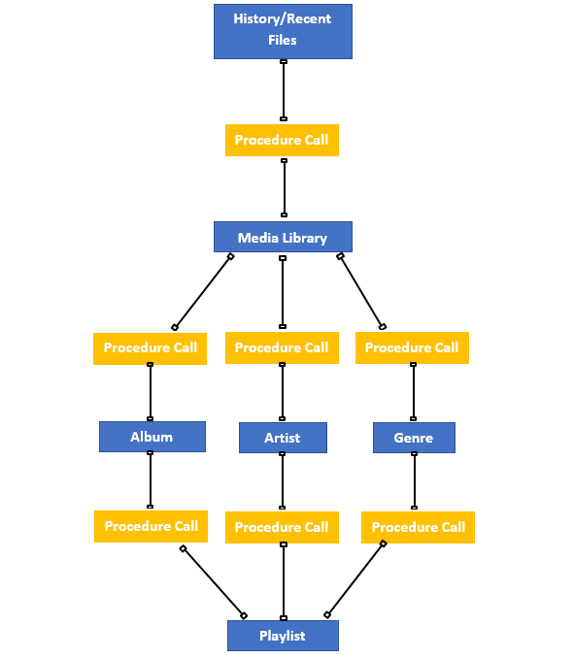
Components and Connectors

Slide 9
Architectural Pattern
MVC has many issues when it is applied to Android
Too tightly tied with Android API’s
Controller is tightly coupled with View in MVC
We chose MVP (Model-View-Presenter) as architectural pattern

Slide 10
Why was MVP chosen?
MVP gets rid of most of the MVC problems
MVP is similar to MVC so it still has a lot of the benefits
MVP still has problems but it was probably the preference of the team making the app

Slide 11
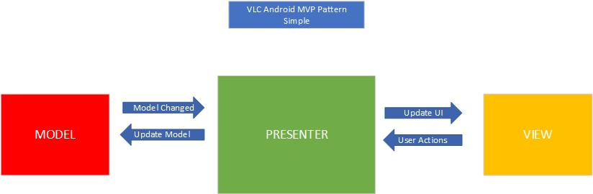
MVP Architecture for VLC Android
Why does MVP (Model View Presenter) work as good architecture for VLC android?

Slide 12
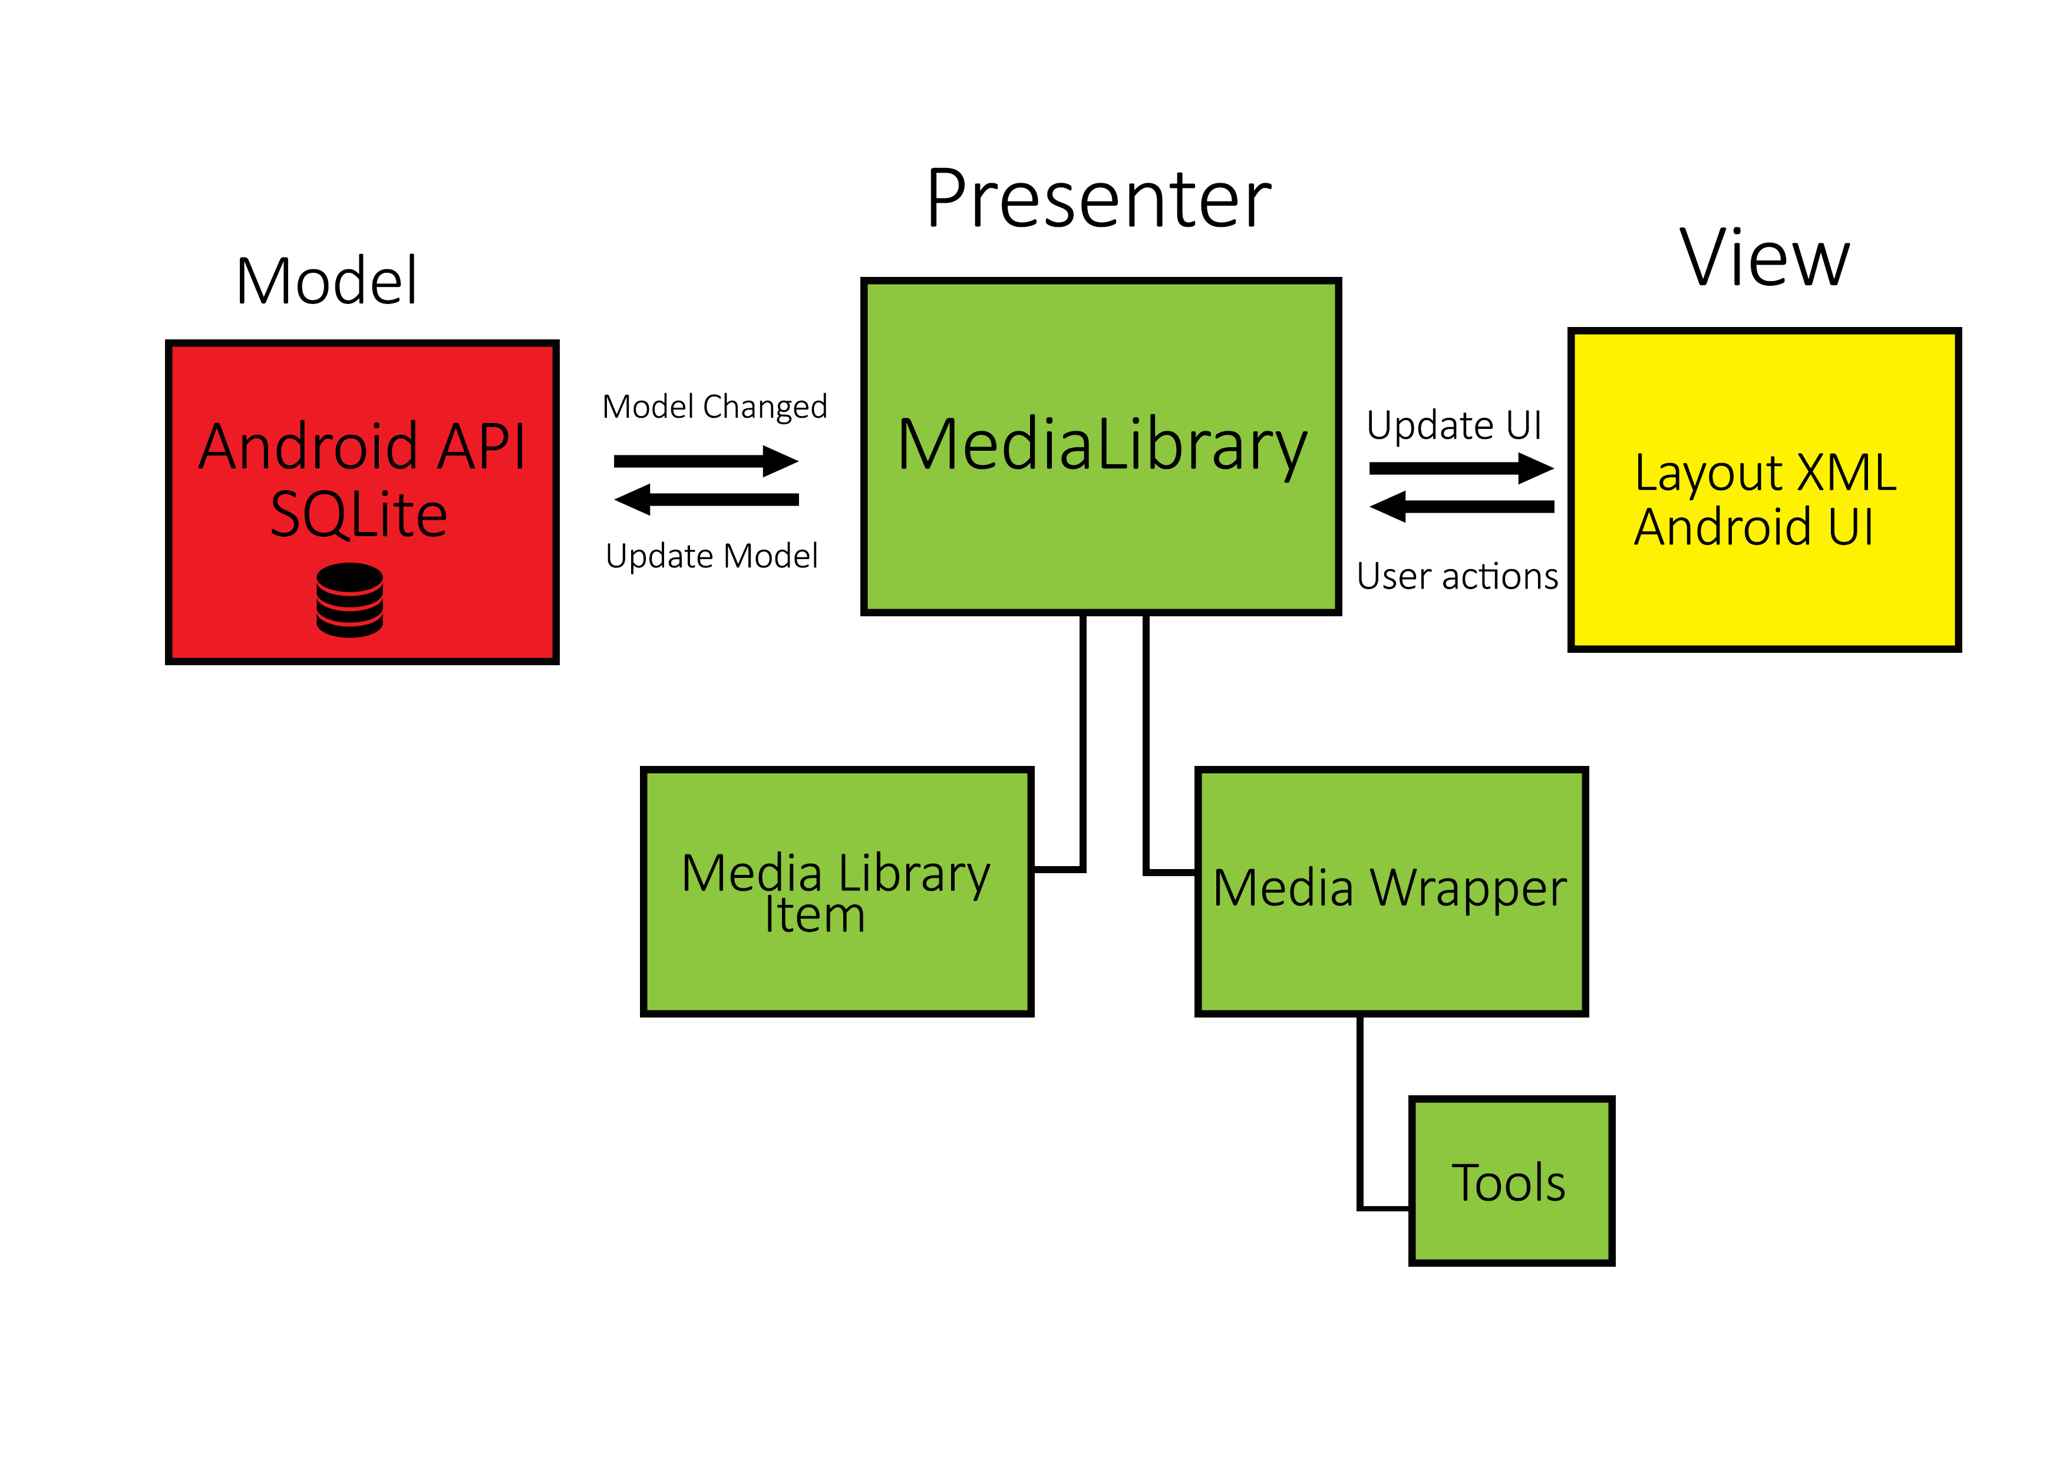
MVP Architecture for VLC Android

Slide 13
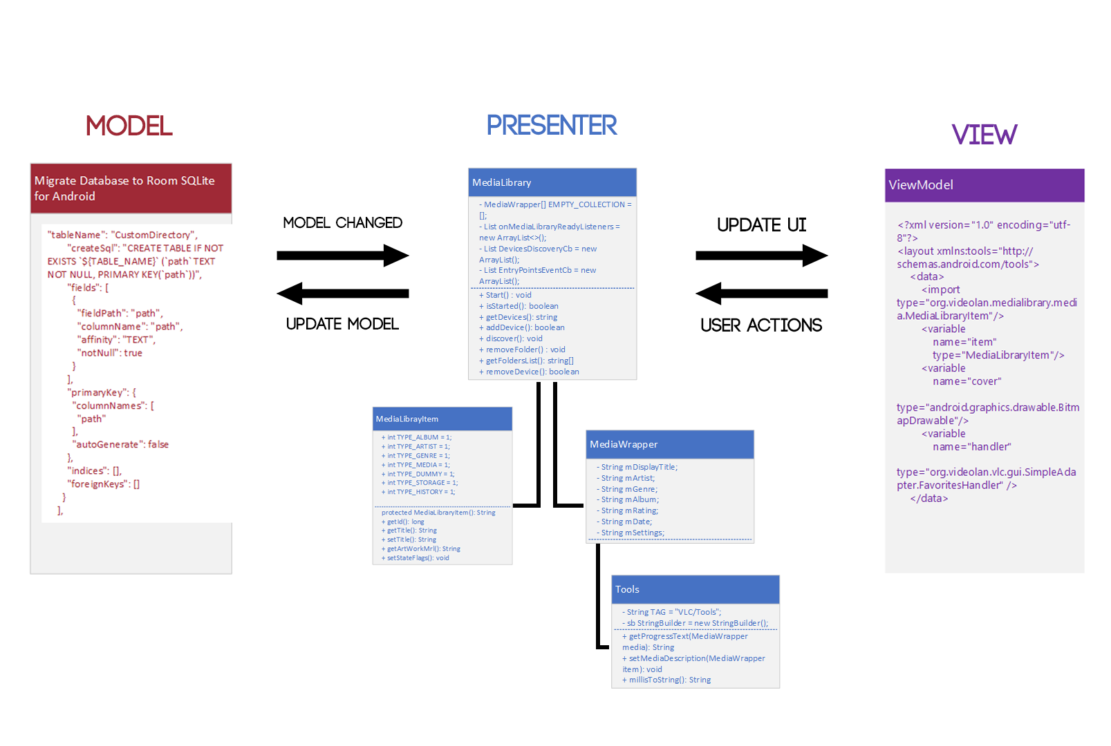
MVP Architecture for VLC Android

Slide 14
MVP Architecture for VLC Android
The model consists of two parts. Local Database and Androids SQLite API service.
This architecture style is mainly used for UI applications such as VLC android

Slide 15
MVP Architecture for VLC Android
The view uses androids ‘Layout’ service.
This uses Androids XML vocabulary to quickly design UI layouts.

Slide 16
Negatives of MVP architecture structuring
Requires more time and effort and structuring of code.
It can become very complicated as the presenter is the main chunk of the program and contains most of the logic.
The aim of MVP is to simplify but it can do the opposite.

Slide 17
Quality Aspects of VLC android
Testability
100 million downloads on google play; 7 years of different devices

Slide 18
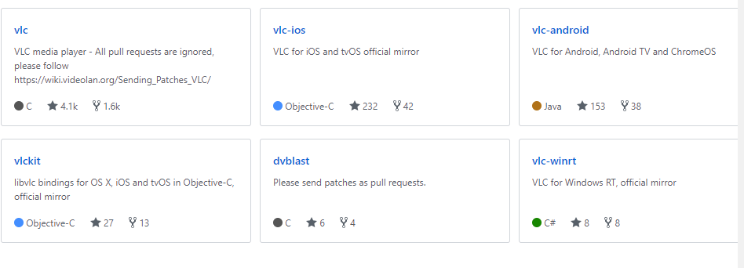
Quality Aspects of VLC android
Portability – the result of open source

Slide 19
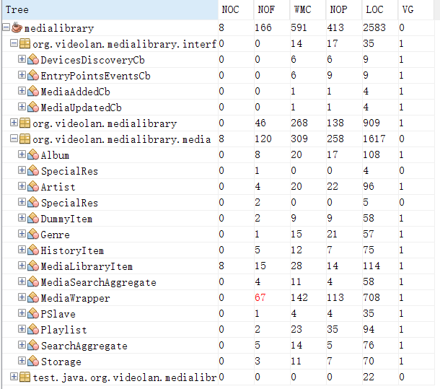
Software Metrics
Lines of Code (LOC)
Number of Children (NOC)
Weighted Method Count (WMC)

Slide 20
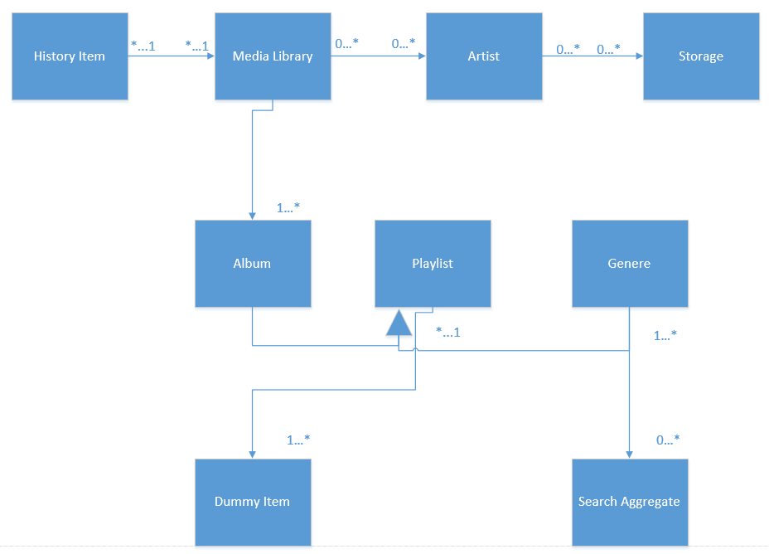
Coupling Between Objects

Slide 21
Questions?

